Slide 1
Reductions

Slide 2



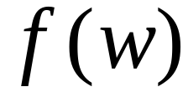
Computable function :
There is a deterministic Turing machine
which for any input string computes
and writes it on the tape

Slide 3


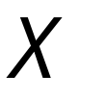
Problem is reduced to problem
If we can solve problem
then we can solve problem

Slide 4


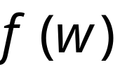



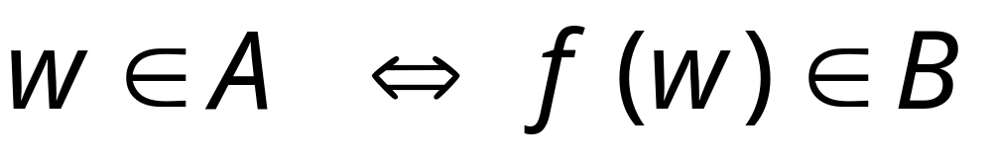
Definition:
Language
is reduced to
language
There is a computable
function (reduction) such that:

Slide 5


Theorem 1:
If: Language is reduced to
and language is decidable
Then: is decidable
Proof:
Basic idea:
Build the decider for
using the decider for

Slide 6


Decider for
Input
string
YES
accept
YES
accept
Decider
for
(halt)
Reduction
NO
reject
NO
reject
(halt)
From reduction:
END OF PROOF

Slide 7
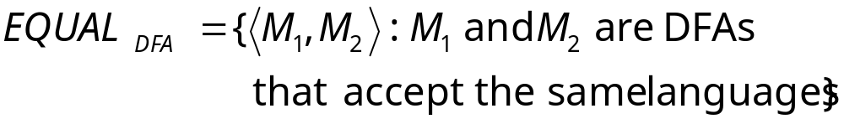
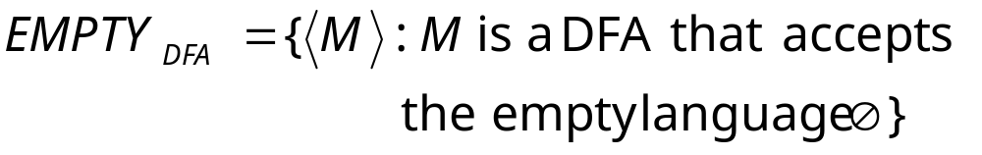
Example:
is reduced to:

Slide 8
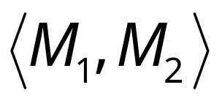
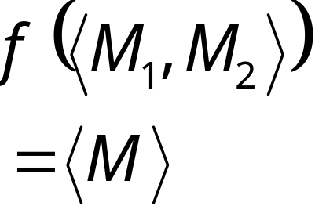

We only need to construct:
Reduction
Turing Machine
for reduction
DFA

Slide 9

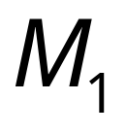

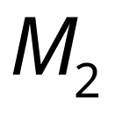

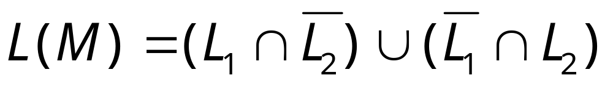
Let be the language of DFA
Let be the language of DFA
Reduction
Turing Machine
for reduction
DFA
construct DFA
by combining and so that:

Slide 10
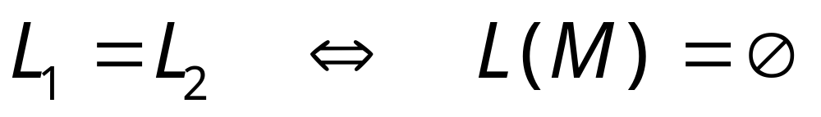

Slide 11
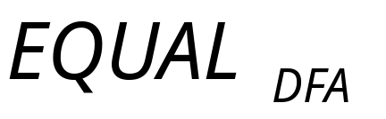
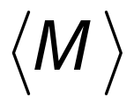
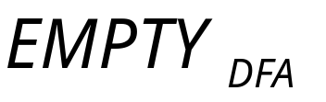
Decider for
Input
string
YES
YES
Decider
Reduction
NO
NO

Slide 12
Theorem 2:
If: Language is reduced to
and language is undecidable
Then: is undecidable
Proof:
Suppose is decidable
Using the decider for
build the decider for
Contradiction!

Slide 13

If is decidable then we can build:
Decider for
Input
string
YES
accept
YES
accept
Decider
for
(halt)
Reduction
NO
reject
NO
reject
(halt)
CONTRADICTION!
END OF PROOF

Slide 14


Observation:
To prove that language is undecidable
we only need to reduce
a known undecidable language to

Slide 15



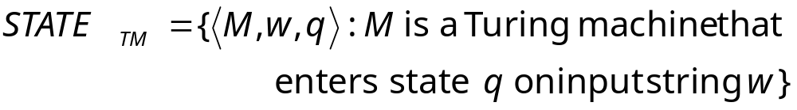
State-entry problem
Input:
Turing Machine
State
String
Question:
Does
enter state
while processing input string ?
Corresponding language:
(while processing)

Slide 16
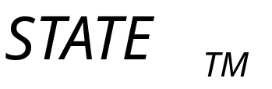
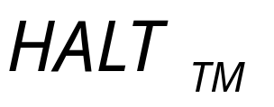
Theorem:
is undecidable
(state-entry problem is unsolvable)
Proof:
Reduce
(halting problem)
to
(state-entry problem)

Slide 17
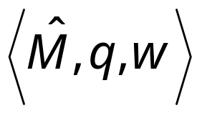
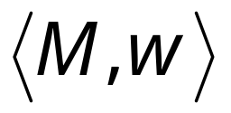
Halting Problem Decider
Decider for
state-entry problem
decider
YES
Decider
YES
Reduction
NO
NO
Given the reduction,
if is decidable,
then is decidable
A contradiction!
since
is undecidable

Slide 18
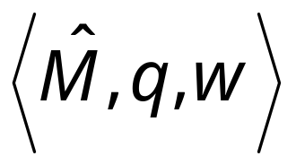
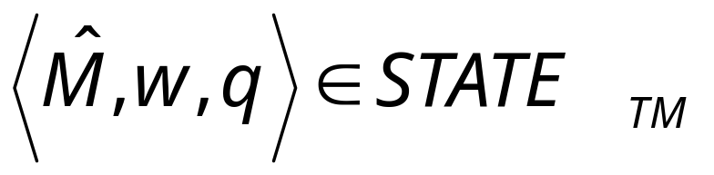
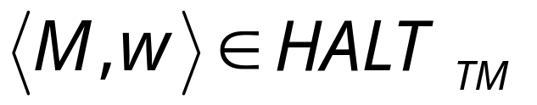
We only need to build the reduction:
Reduction
So that:

Slide 19
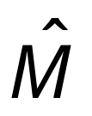



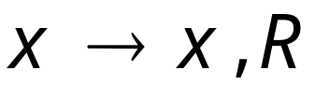

For the reduction, construct from :
special
halt state
halting
states
A transition for every unused
tape symbol of

Slide 20


special
halt state
halting
states
halts
halts on state

Slide 21
Therefore:
halts on input
halts on state on input
Equivalently:
END OF PROOF

Slide 22
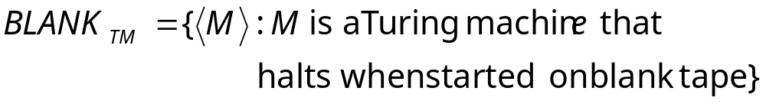
Blank-tape halting problem
Input:
Turing Machine
Question:
Does
halt when started with
a blank tape?
Corresponding language:

Slide 23
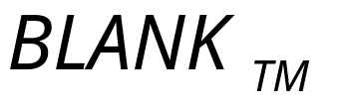
Theorem:
is undecidable
(blank-tape halting problem is unsolvable)
Proof:
Reduce
(halting problem)
to
(blank-tape problem)

Slide 24

Halting Problem Decider
Decider for
blank-tape problem
decider
YES
Decider
YES
Reduction
NO
NO
Given the reduction,
If is decidable,
then is decidable
A contradiction!
since
is undecidable

Slide 25
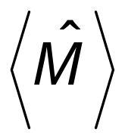
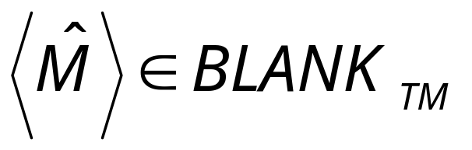
We only need to build the reduction:
Reduction
So that:

Slide 26





Construct from :
no
Accept and halt
Tape is blank?
yes
Run
Write on tape
with input
If halts then halts too

Slide 27
no
Accept and halt
Tape is blank?
yes
Run
Write on tape
with input
halts on input
halts when started on blank tape

Slide 28
halts on input
halts when started on blank tape
Equivalently:
END OF PROOF

Slide 29
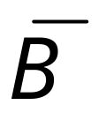
Theorem 3:
If: Language is reduced to
and language is undecidable
Then: is undecidable
Proof:
Suppose is decidable
Then is decidable
Using the decider for
build the decider for
Contradiction!

Slide 30


Suppose is decidable
reject
Decider
for
(halt)
accept
(halt)

Slide 31

Suppose is decidable
Then is decidable
Decider for
NO
reject
YES
accept
Decider
for
(halt)
YES
NO
accept
reject
(halt)

Slide 32

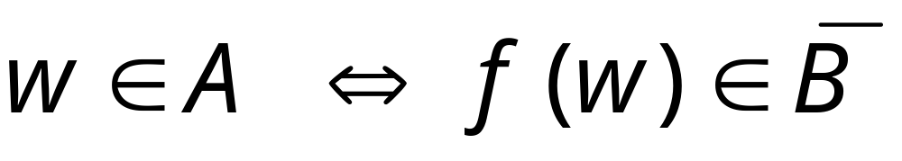
If is decidable then we can build:
Decider for
Input
string
YES
accept
YES
accept
Decider
for
(halt)
Reduction
NO
reject
NO
reject
(halt)
CONTRADICTION!

Slide 33
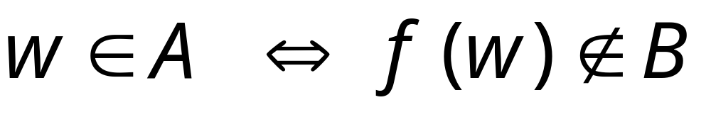
Alternatively:
Decider for
Input
string
NO
reject
YES
accept
Decider
for
(halt)
Reduction
YES
NO
accept
reject
(halt)
CONTRADICTION!
END OF PROOF

Slide 34
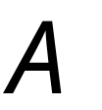

Observation:
To prove that language is undecidable
we only need to reduce
a known undecidable language
to
or
(Theorem 2)
(Theorem 3)

Slide 35

Undecidable Problems for
Turing Recognizable languages
Let be a Turing-acceptable language
is empty?
is regular?
has size 2?
All these are undecidable problems

Slide 36
Let be a Turing-acceptable language
is empty?
is regular?
has size 2?

Slide 37
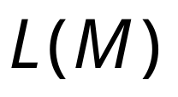
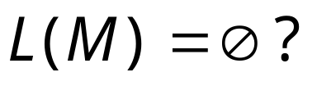
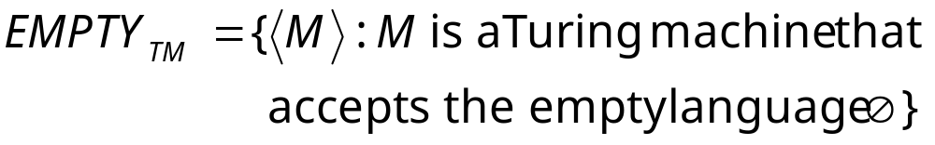
Empty language problem
Input:
Turing Machine
Question:
Is
empty?
Corresponding language:

Slide 38
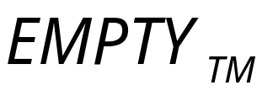
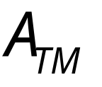
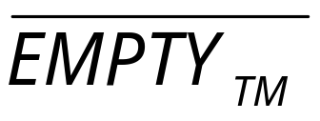
Theorem:
is undecidable
(empty-language problem is unsolvable)
Proof:
Reduce
(membership problem)
to
(empty language problem)

Slide 39
membership problem decider
Decider for
empty problem
decider
YES
Decider
YES
Reduction
NO
NO
Given the reduction,
if is decidable,
then is decidable
A contradiction!
since
is undecidable

Slide 40
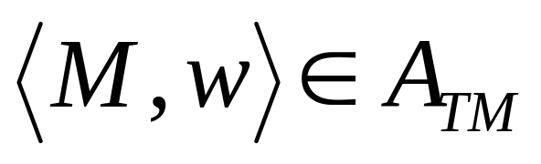
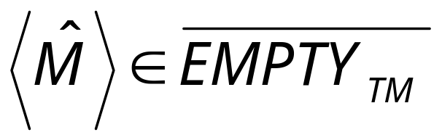
We only need to build the reduction:
Reduction
So that:

Slide 41

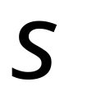



Construct from :
Tape of
input string
Turing Machine
Accept
yes
yes
Write on tape, and
accepts ?
Simulate on input

Slide 42
The only possible accepted string
Louisiana
Turing Machine
Accept
yes
yes
Write on tape, and
accepts ?
Simulate on input

Slide 43
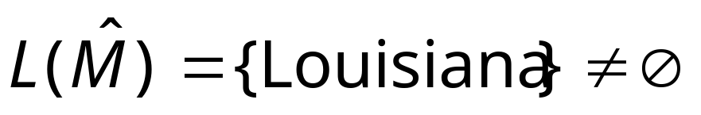
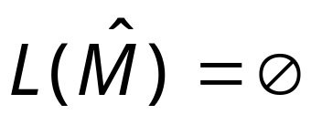
accepts
does not
accept
Turing Machine
Accept
yes
yes
Write on tape, and
accepts ?
Simulate on input

Slide 44
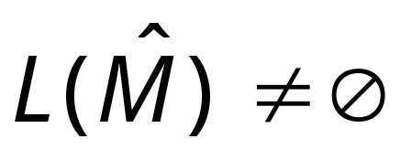

Therefore:
accepts
Equivalently:
END OF PROOF

Slide 45
Let be a Turing-acceptable language
is empty?
is regular?
has size 2?

Slide 46
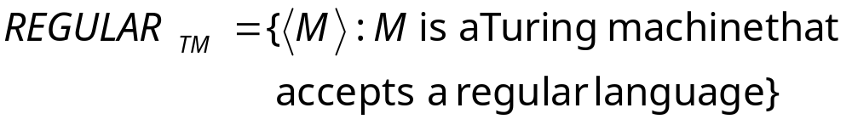
Regular language problem
Input:
Turing Machine
Question:
Is
a regular language?
Corresponding language:

Slide 47

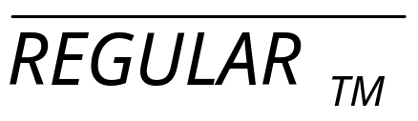
Theorem:
is undecidable
(regular language problem is unsolvable)
Proof:
Reduce
(membership problem)
to
(regular language problem)

Slide 48
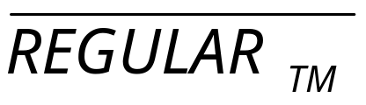
membership problem decider
Decider for
regular problem
decider
YES
Decider
YES
Reduction
NO
NO
Given the reduction,
If is decidable,
then is decidable
A contradiction!
since
is undecidable

Slide 49
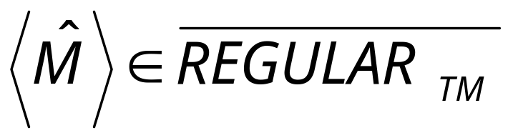
We only need to build the reduction:
Reduction
So that:

Slide 50

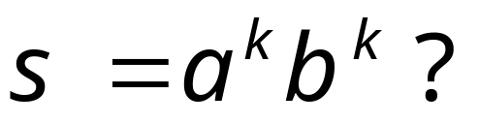
Construct from :
Tape of
input string
Turing Machine
Accept
yes
yes
Write on tape, and
accepts ?
Simulate on input

Slide 51

not regular
accepts
does not
accept
regular
Turing Machine
Accept
yes
yes
Write on tape, and
accepts ?
Simulate on input

Slide 52

Therefore:
accepts
is not regular
Equivalently:
END OF PROOF

Slide 53
Let be a Turing-acceptable language
is empty?
is regular?
has size 2?

Slide 54


Size2 language problem
Input:
Turing Machine
Question:
Does have size 2 (two strings)?
Corresponding language:

Slide 55

Theorem:
is undecidable
(size2 language problem is unsolvable)
Proof:
Reduce
(membership problem)
to
(size 2 language problem)

Slide 56
membership problem decider
Decider for
size2 problem
decider
YES
Decider
YES
Reduction
NO
NO
Given the reduction,
If is decidable,
then is decidable
A contradiction!
since
is undecidable

Slide 57

We only need to build the reduction:
Reduction
So that:

Slide 58

Construct from :
Tape of
input string
Turing Machine
Accept
yes
yes
Write on tape, and
accepts ?
Simulate on input

Slide 59

2 strings
accepts
does not
accept
0 strings
Turing Machine
Accept
yes
yes
Write on tape, and
accepts ?
Simulate on input

Slide 60
Therefore:
accepts
has size 2
Equivalently:
END OF PROOF

